Slide 1
Open Security Controls Assessment Language (OSCAL) MaY 4th, 2017
16
Notes:
Moved the logo to the top left corner

Slide 2
Agenda
OSCAL ARCHITECTURE
RECAP of RECENT decisions
Current status
Next steps
Open floor discussion
Notes:
Removed the Use Case item

Slide 3
Oscal CORE layers
CORE SCHEMAS
Metrics Schema: Defines the structure of the XML document describing metrics and measurements for the system.
System Assessment Schema: Defines the structure of the XML document describing how the system assessment is performed.
Implementation Schema:
Defines the structure of the XML document describing how the profile items are implemented
= System Security Plan
Implementation Extension Schema: Defines specific structures of the XML document.
Profile Schema (formerly Overlay) : Defines the structure of the XML document describing a customized subset of controls or requirements inherited from one or more OSCAL catalogs
System Assessment Objectives (**Catalog Schema):
Defines assessment criteria for the selected OSCAL catalog items
Catalog Extension Schema: Defines specific structures pertaining to a catalog or standard
Catalog Schema: Defines the structure of the XML catalog or standard of security and privacy controls and/or requirements

Slide 4
OSCAL schemas
OSCAL Core
OSCAL Extension
uses
Catalog
Profile
Implementation
[ Assessment Objectives]
System Assessment
Metrics
…
uses
e.g. 800-53-extension
build from
80%
build from
OSCAL Core
- defines the foundational elements that instances will build from
OSCAL Extension
- defines elements considered specific to a given context – e.g., NIST SP 800-53, PCI DSS, HIPAA
20%
Specific XML instances
e.g. 800-53-catalog

Slide 5
ASSESSMENT
ASSESSMENT
RESULTS
Select/Filter/Add/
Modify/Remove
MECHANISM
IMPLEMENTATION
ASSESSMENT
OBJECTIVES
METRICS
PROFILE
Select/Filter/Add/Modify/Remove
CATALOG

Slide 6
There is an understanding that a moderate baseline contains all controls from low baseline, but people often use different ways of representing the data: some are repeating the controls , others are only recording the new controls and enhancements. WE NEED A CONSISTENT WAY OF REPRESENTING AND CREATING PROFILES
FedRAMP Moderate Baseline
FR-1
FR-2
FR-3
?
PROFILES
MB-1
MB-2
MB-3
800-53 Moderate Baseline
800-53 Low Baseline
LB-1
?
CATALOGS
800-53
CA-2
CA-2(1)
CA-2(2)
MyCatalog
CA-2(9)

Slide 7
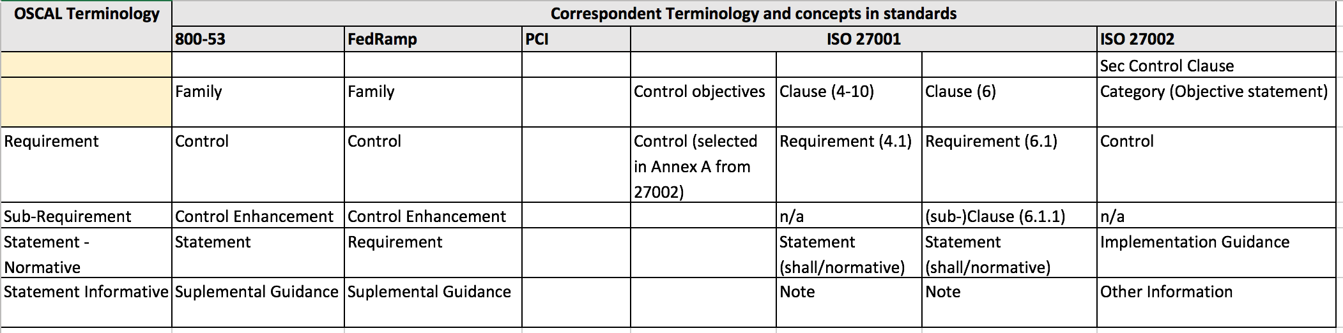

Slide 8
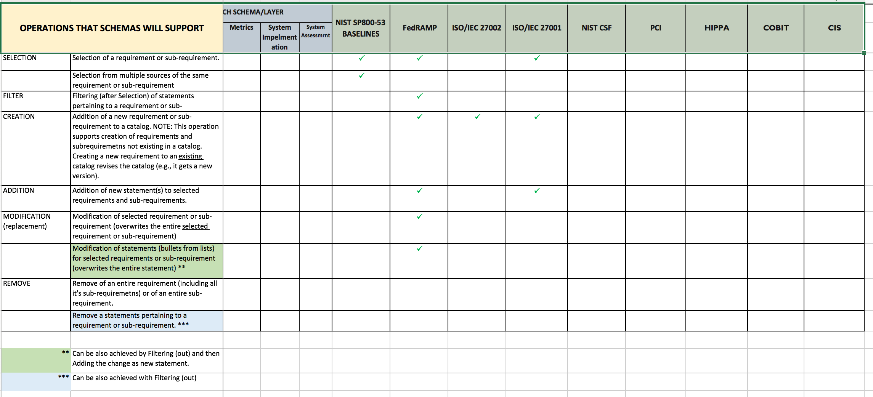

Slide 9
Request 1
A Statement
B Statement
C Statement
SubRequest 1.1
M Statement
N Statement
P Statement
FedRAMP Profile
SELECT Req 1
FILTER(A, C)
?= (A,B) OR (C)
SELECT SubReq 1.1
FILTER(M, P)
?= (M, P) OR (N)
SELECT
SELECT
?= SELECT(Req1) + SELECT(sReq1.1)
Request 1
A Statement
B Statement
C Statement
SubRequest 1.1
M Statement
N Statement
P Statement
Parent
(parent link)
Type of Statements:
“Requirements” - NORMATIVE
“Supplemental Guidance” - INFORMATIVE

Slide 10
Open floor discussion

